Slide 1

BANGALORE INSTITUTE OF TECHNOLOGY
DEPARTMENT OF ARTIFICIAL INTELLIGENCE AND MACHINE LEARNING
PROJECT PRESENTATION ON
“OLA RIDE REQUEST FORECAST USING ML”
PRESENTED BY:
Group No - 28
Dhruv Vashishtha(1BI20AI012)
Bhoogarv Maheshwary(1BI20AI008)
UNDER THE GUIDANCE OF :
MRS. SUBHA MEENAKSHI S

Slide 2
ABSTRACT
This project focuses on addressing operational challenges faced by Ola Bikes, specifically inefficient driver allocation leading to operational losses and increased competition. The goal is to predict ride demand in a specified region and time window, enabling intelligent driver allocation.
The dataset includes user IDs, ride timestamps, and geographical coordinates. Ola's guidelines cover multiple bookings, short time intervals, fraud detection based on geodesic distance, and system errors.
The objective is to develop a demand forecasting model considering these guidelines, filtering out invalid requests, and optimizing temporal and spatial aspects. Ola aims to enhance efficiency, reduce losses, and improve competitiveness, especially in key regions like Karnataka, by strategically allocating resources based on the model's predictions.

Slide 3
CONTENTS
Introduction
Literature Survey
Proposed System
Problem Statement
Objective
System Architecture
Libraries Used
Conclusion

Slide 4
INTRODUCTION
This project aims to address the operational challenges faced by Ola Bikes, a prominent ride-sharing service, by developing a demand forecasting model.
The primary issue is the inability to efficiently fulfill ride requests, resulting in operational losses and increased competition. The project uses a dataset of ride requests from Ola’s users, containing information such as user IDs, timestamps, and geographical coordinates. The project also follows guidelines provided by Ola’s business team, such as handling multiple bookings, detecting fraud, and identifying serviceable areas.

Slide 5
LITERATURE SURVEY
Sl. No. | Title | Author | Year | Contributions & Drawbacks
1 | Taxi Demand Prediction using Machine Learning. IRJET, Volume 10, Issue 05. | P. Sudheer Benarji, Professor, VNR Vignana Jyothi Institute of Engineering & Technology, Hyderabad P. Sai Bharadwaj, Under Graduate Student, VNR Vignana Jyothi Institute of Engineering & Technology, Hyderabad B. Neeha, Under Graduate Student, VNR Vignana Jyothi Institute of Engineering & Technology, Hyderabad D. Srikanth, Under Graduate Student, VNR Vignana Jyothi Institute of Engineering & Technology, Hyderabad | 2023 | Contributions: The paper proposes a model to analyze data-patterns and predict the demand of taxis based on number of requests in a given time period. The paper uses various machine learning techniques such as regression analysis and time series forecasting to train and test the model. Drawbacks: The paper does not provide any details on the data preprocessing, feature extraction, and model selection steps. The paper does not explain how the models handle the spatiotemporal dynamics and heterogeneity of taxi demand.

Slide 6
Sl. No. | Title | Author | Year | Contributions & Drawbacks
2 | Taxi demand forecast using the random forest model IRJET, Volume 8, Issue 03. | Tanouz et al. | 2021 | Contributions: Decision trees are employed in the random forest. The term "random" refers to our usage of a random bootstrap sampling, and the term "forest" refers to the collection of trees seen in decision trees. (Achieved 77% Accuracy). excellent forecasting abilities that improve application precision. Easy data preparation is made possible by not requiring normalization. Drawbacks: Generally speaking, this algorithm is quick to train but takes a while to produce predictions after training

Slide 7
Sl. No. | Title | Author | Year | Contributions & Drawbacks
3 | Taxi Demand Forecast Based on Regional Heterogeneity Analysis and Multi-Level Deep Learning | V. Ankitha, Under Graduate Student, VNR Vignana Jyothi Institute of Engineering & Technology, Hyderabad | 2021 | Contributions: With the aid of the taxi zone clustering technique and pairwise clustering theory, the Multi-Level Recurrent Neural Networks (MLRNN) model is put out.(83.33% Accuracy Attained). concentrates on how to exploit inter-zone heterogeneity to enhance prediction. Drawbacks: The use of MLRNN results in high processing costs and greater complexity when fitting data.

Slide 8
Sl. No. | Title | Author | Year | Contributions & Drawbacks
4 | BICYCLE AND PEDESTRIAN TRAVEL DEMAND FORECASTING | Shawn Turner, Aaron Hottenstein, and Gordon Shunk | 2020 | Contribution: The paper offers some useful recommendations for selecting and validating a preferred demand forecasting model or methodology, based on the data availability, accuracy, applicability, and expectations of the users and stakeholders. Drawback: The paper does not present any empirical validation of the models or methodologies discussed, nor does it compare their performance or results with actual bicycle and pedestrian counts or surveys. This limits the credibility and usefulness of the paper for practitioners and researchers. The paper does not consider the effects of other factors, such as land use, urban design, policy, and behavior, on bicycle and pedestrian travel demand. This reduces the scope and applicability of the paper for different contexts and scenarios.

Slide 9
PROPOSED SYSTEM
Proposed System: The proposed system is a machine learning model that predicts ride demand for a specific region and future time window, based on the historical and current data of ride requests.
The model incorporates feature engineering, data preprocessing, and regression techniques to capture the temporal and spatial patterns of ride demand.
The model also filters out invalid or fraudulent requests, and adjusts the predictions according to the geographical constraints.
The model’s output will enable Ola to allocate drivers more intelligently, optimize service delivery, and improve customer satisfaction.

Slide 10
PROBLEM STATEMENT
Ola is facing operational challenges, resulting in losses and a decline in competitiveness due to inefficient driver allocation to meet user ride requests
The company seeks a solution to accurately predict ride demand for a specific region and future time window, aiming to optimize driver allocation and enhance overall service efficiency.

Slide 11
OBJECTIVES
Develop an Accurate Demand Forecasting Model
Optimize Driver Allocation
Mitigate Fraudulent Ride Requests
Enhance Operational Efficiency and Competitiveness

Slide 12
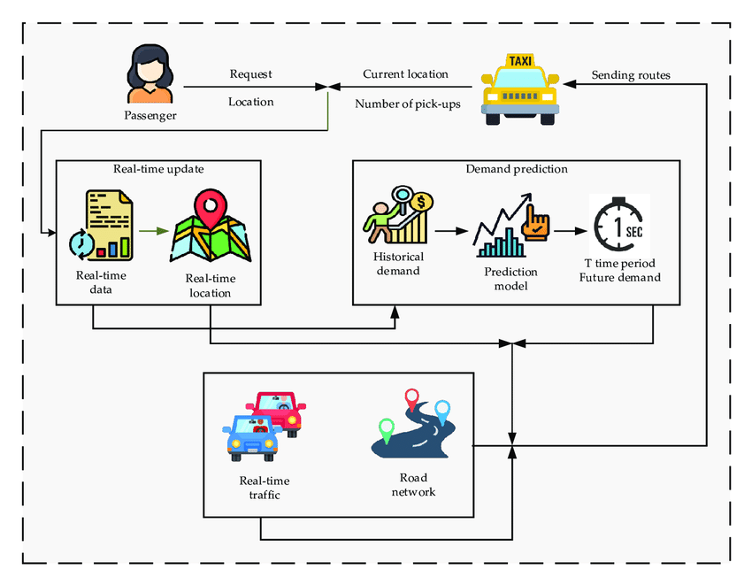
SYSTEM ARCHITECTURE

Slide 13
LIBRARIES
NumPy (for Numerical Analysis)
Pandas (for handling data files)
Matplotlib(for data visualization)
Seaborn(for data visualization)

Slide 14
CONCLUSION
Aims to develop a demand forecasting model for Ola Bikes, a ride-sharing service, to optimize driver allocation and service efficiency.
The model uses a supervised machine learning approach, applying various regression algorithms to predict ride demand for a specific region and time window.
The dataset contains information on user IDs, ride request timestamps, and pickup and drop locations, along with guidelines to ensure the accuracy and validity of the predictions.
The project also explores the future scope of the initiative, such as dynamic pricing, customer segmentation, urban planning, and global expansion.

Slide 15
THANK YOU

